Slide 1

A Frosted Window: Sharing Chemical Data in Open Drug Discovery Networks
Prof Matthew H. Todd (@mattoddchem)
University College London
1) What Have We Been Doing?
2) Why We Want to Scale Up
3) What Solutions for Open Data Will Scale Well?
Open Chemical Science: Data for Chemistry, 12th Nov 2020

Slide 2
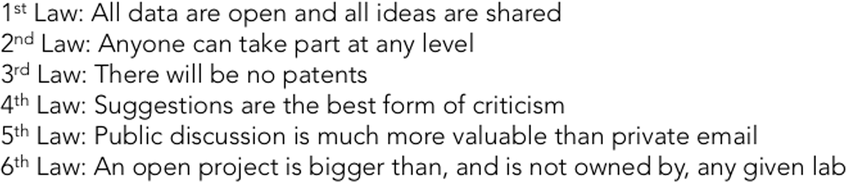
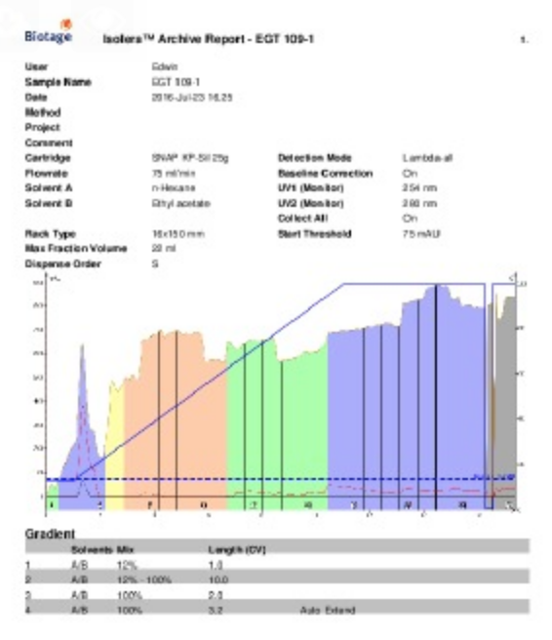
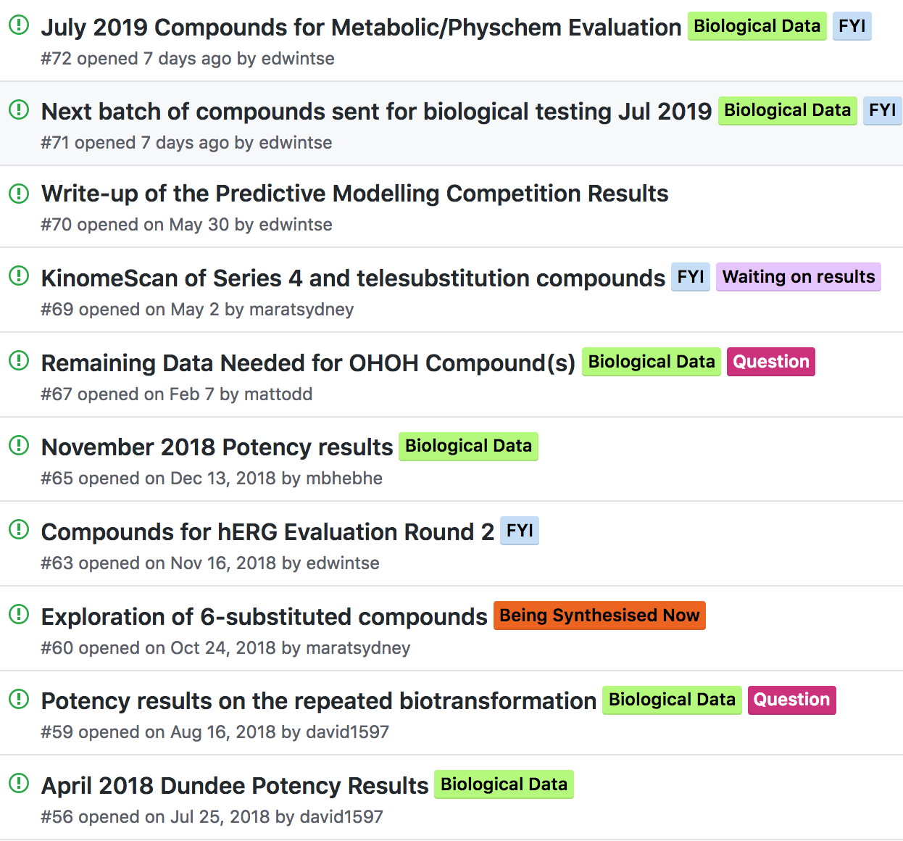
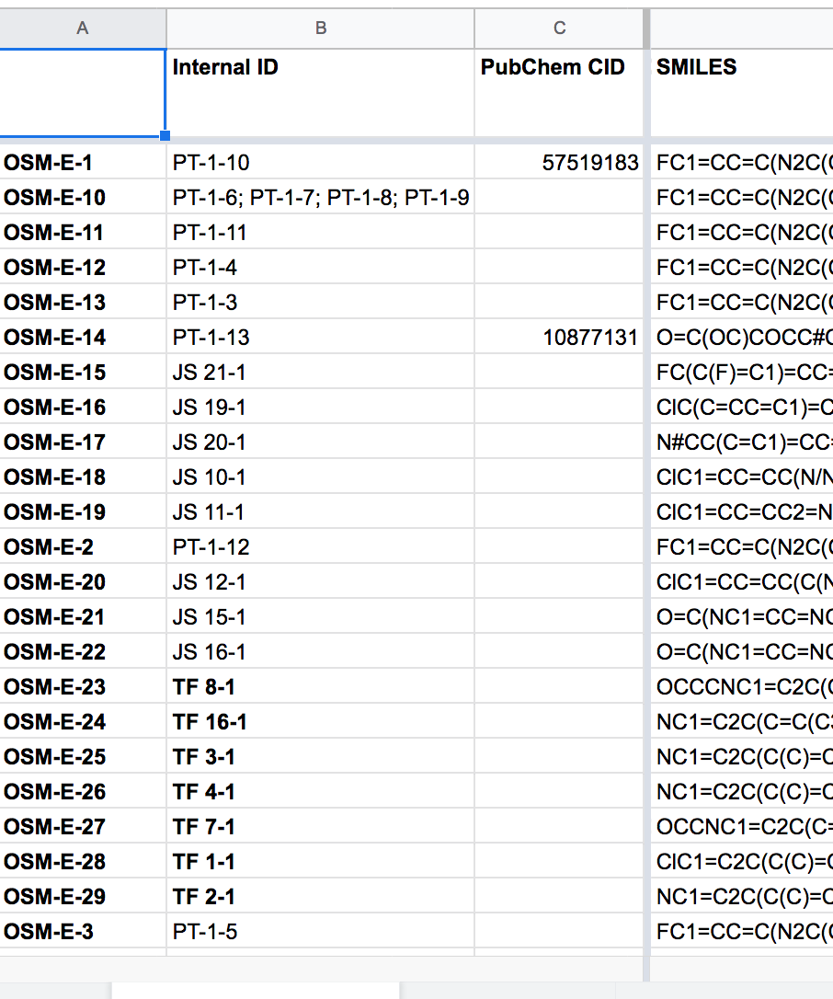
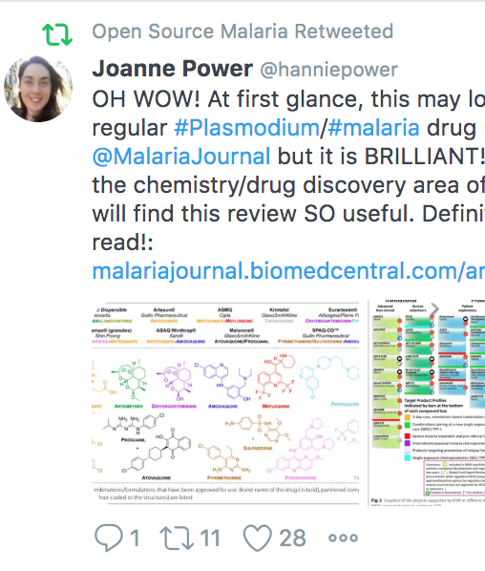
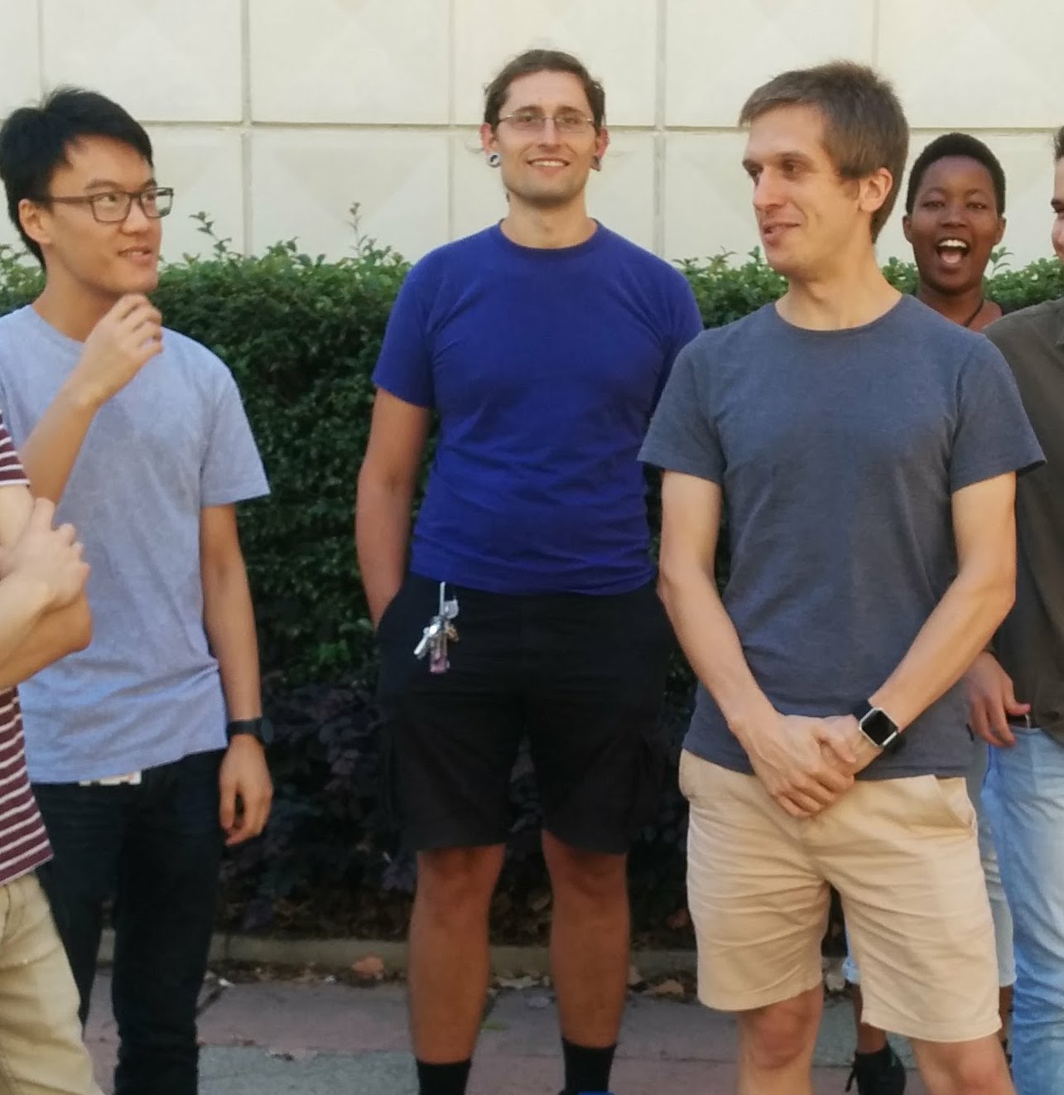
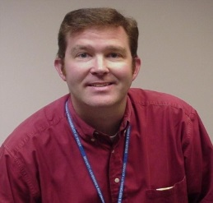
The Approach
2/30
Malaria: ACS Cent. Sci. 2016, 2, 687. TB: J. Med. Chem. 2018, 61, 11327. Antifungals: PLoS NTD 2018, 12(4): e0006437. Platform: Chem. Sci. 2015, 6, 1614; Parasitology 2014, 141, 148. Laws: ChemMedChem, 2019, 14, 1804.
Components
Contributions
Laboratory Notebooks
Public To Do Lists/Discussion
Open Data
Community
Students
Pharma

Slide 3

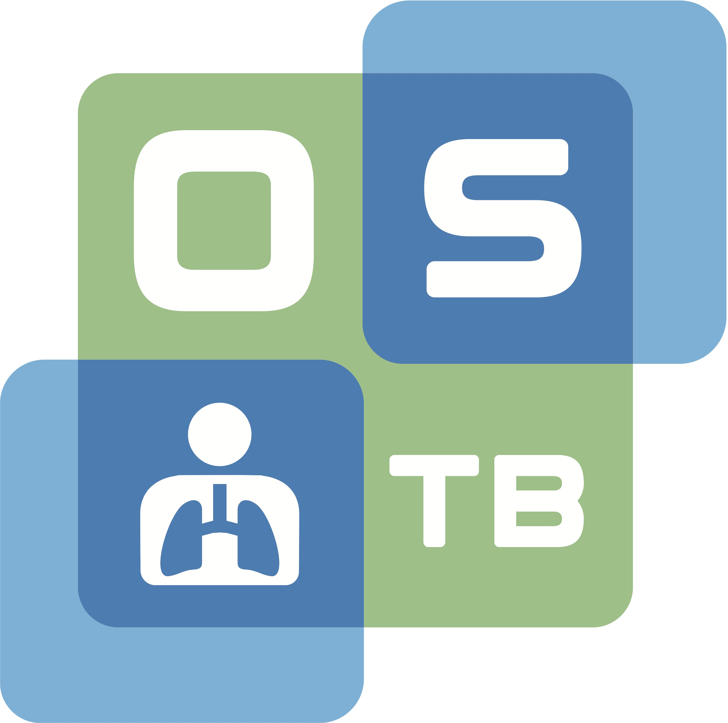
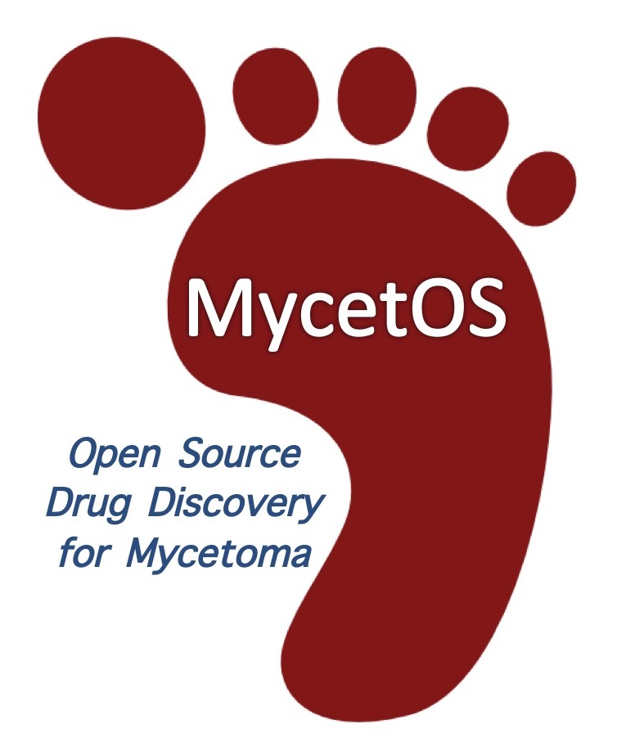


3/30
¢
Open Source TB
@OpenSourceTB
Open Source Pharma
@OSPinfo
Open Source Malaria
@O_S_M
Open Source Mycetoma
@MycetOS
Open Source Antibiotics
@OSantibiotics
$

Slide 4
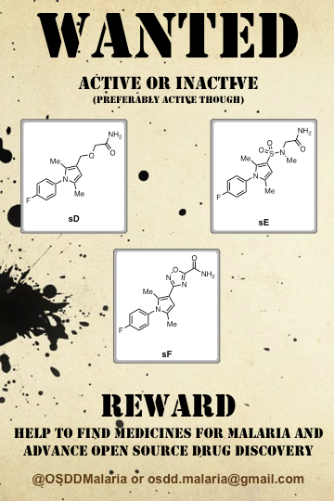
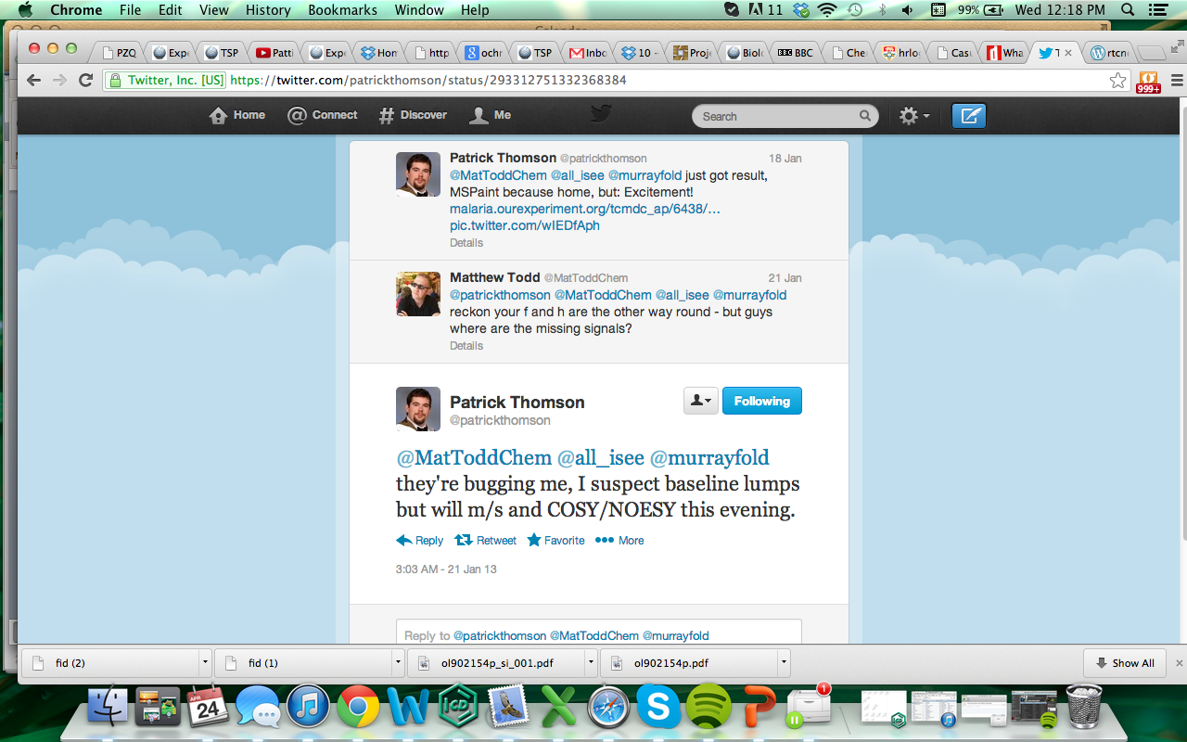
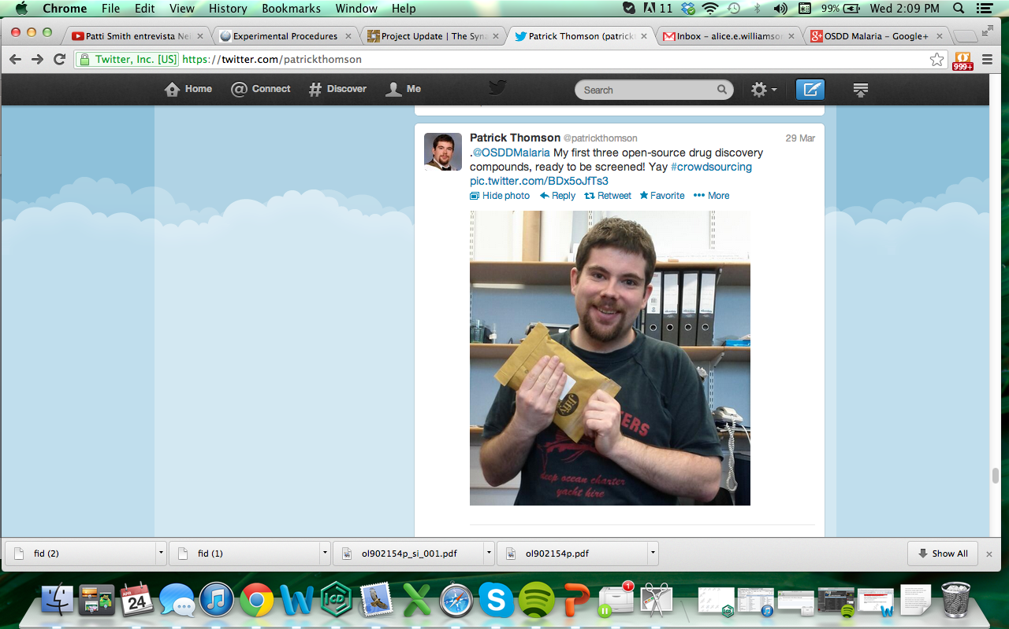
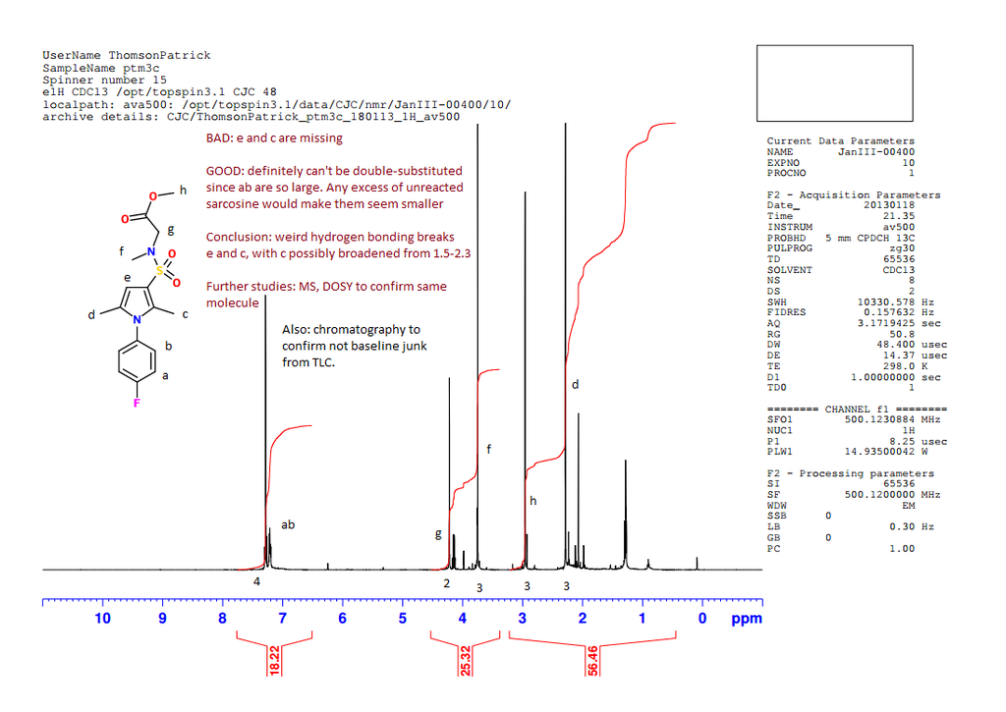
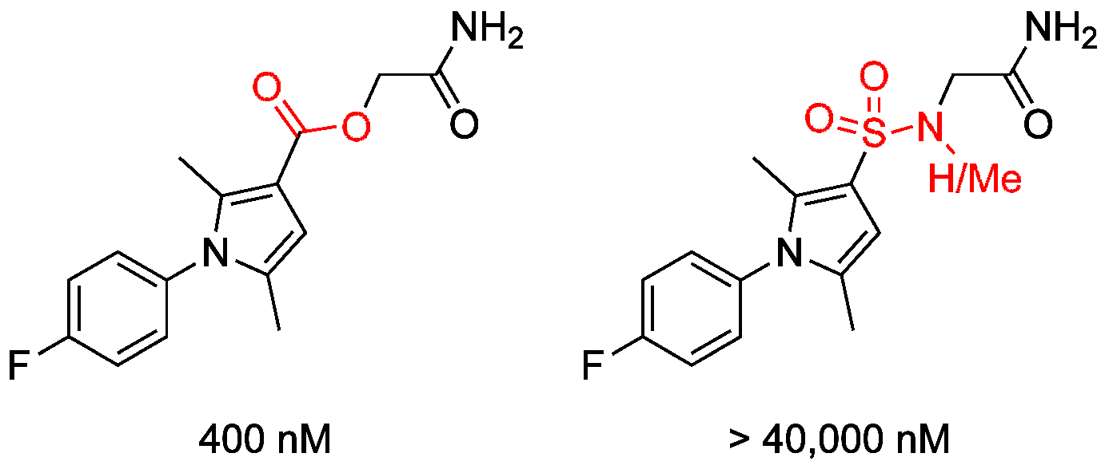
4/30
Early Example from OSM

Slide 5
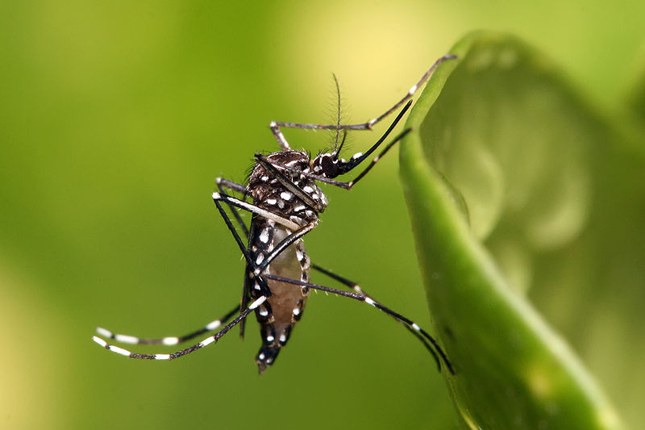
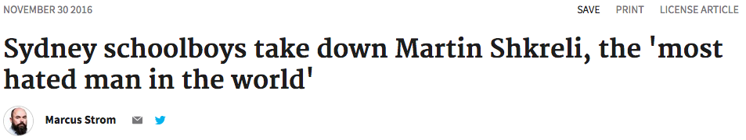
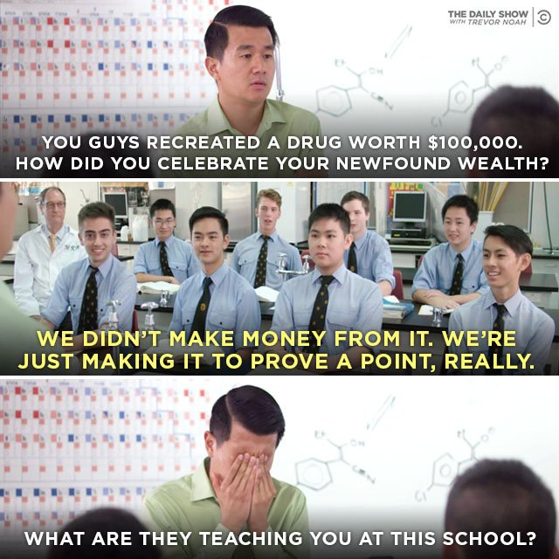
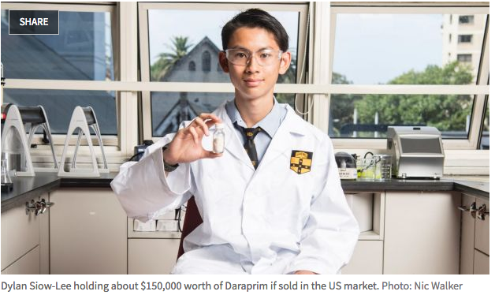
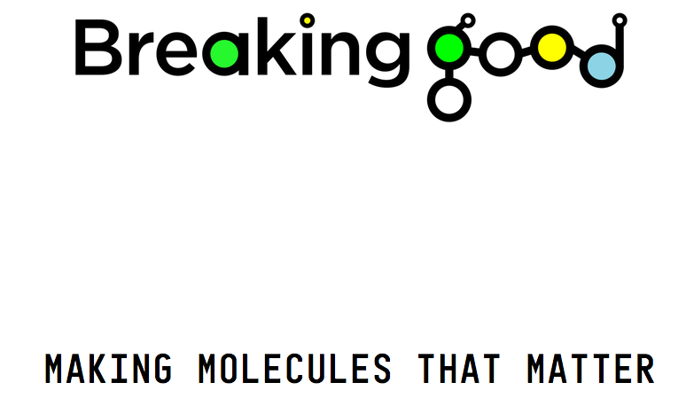
“Breaking Good”
5/30

Slide 6
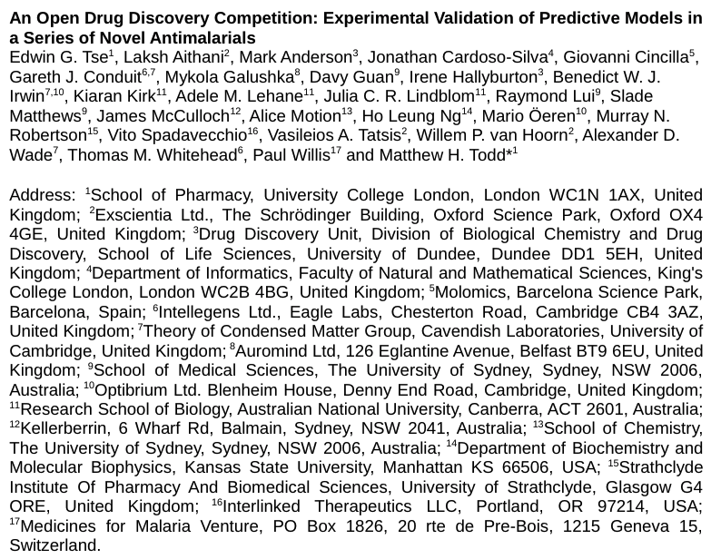
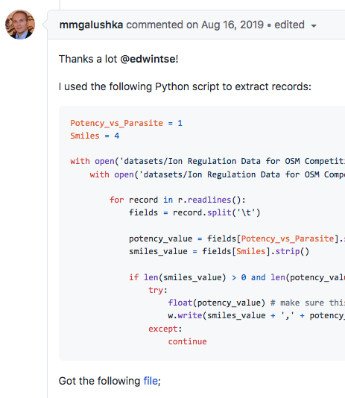
6/30
Recent Example from OSM
https://github.com/OpenSourceMalaria/Series4_PredictiveModel, https://chemrxiv.org/articles/preprint/13194755

Slide 7
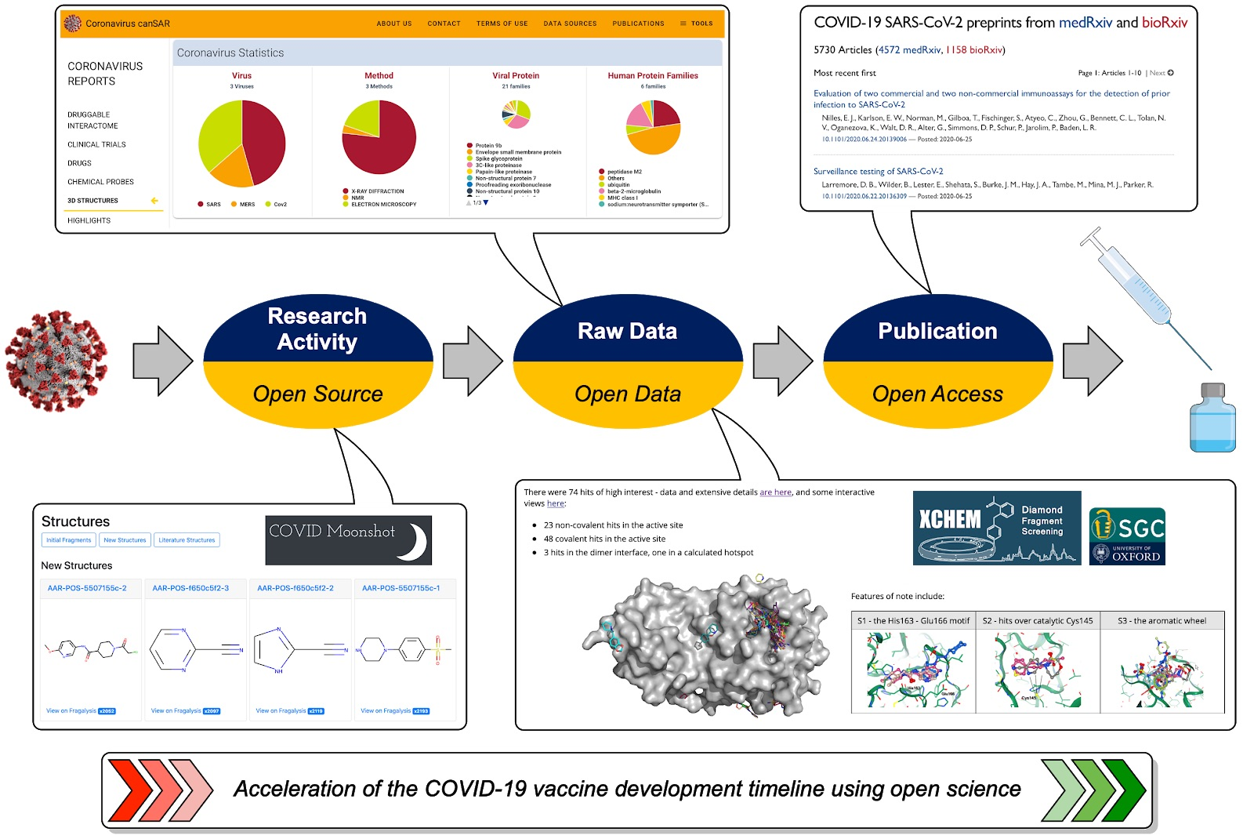
7/30
We All Understand Open is Better
Tse EG, Klug DM and Todd MH. Open science approaches to COVID-19, F1000Research 2020, 9:1043
https://github.com/OpenSourceSarsCoV2/LivingResourceReview

Slide 8
8/30
Seems to work, let’s scale this up

Slide 9
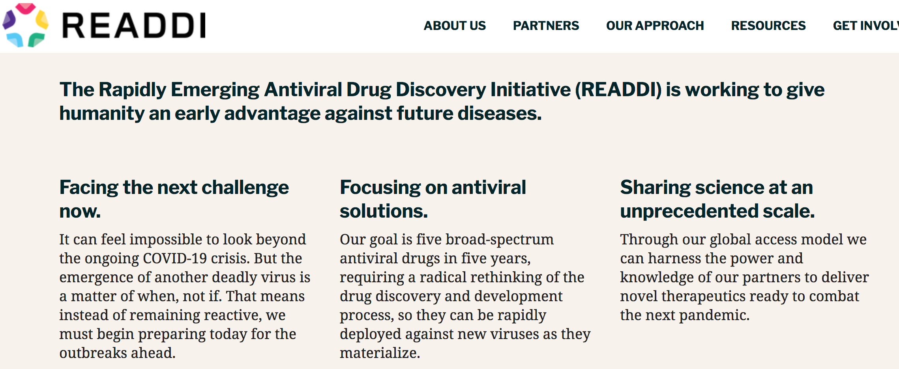
New Antivirals, In Advance
9/30

Slide 10
10/30
The Challenge of the Next Pandemic
Who would fund drug discovery and development for a disease that does not yet exist?

Slide 11
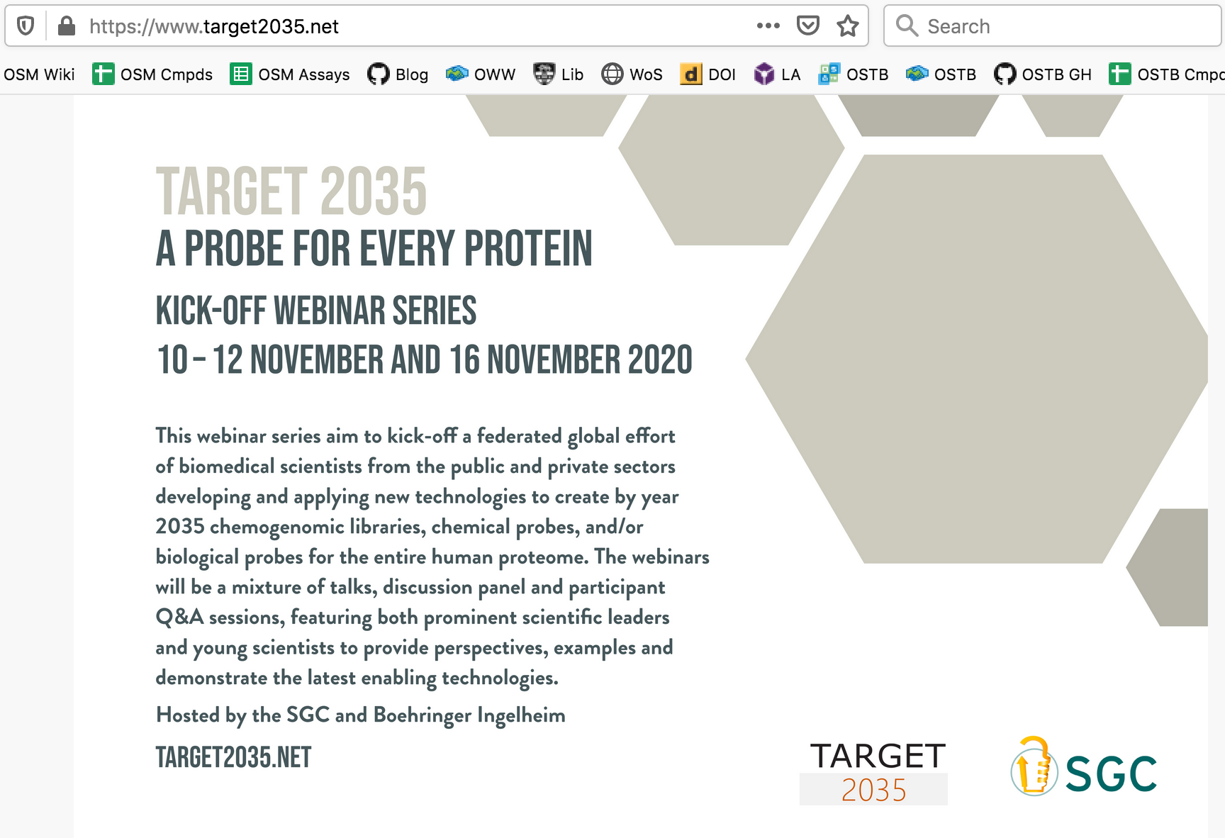
11/30
Target 2035

Slide 12
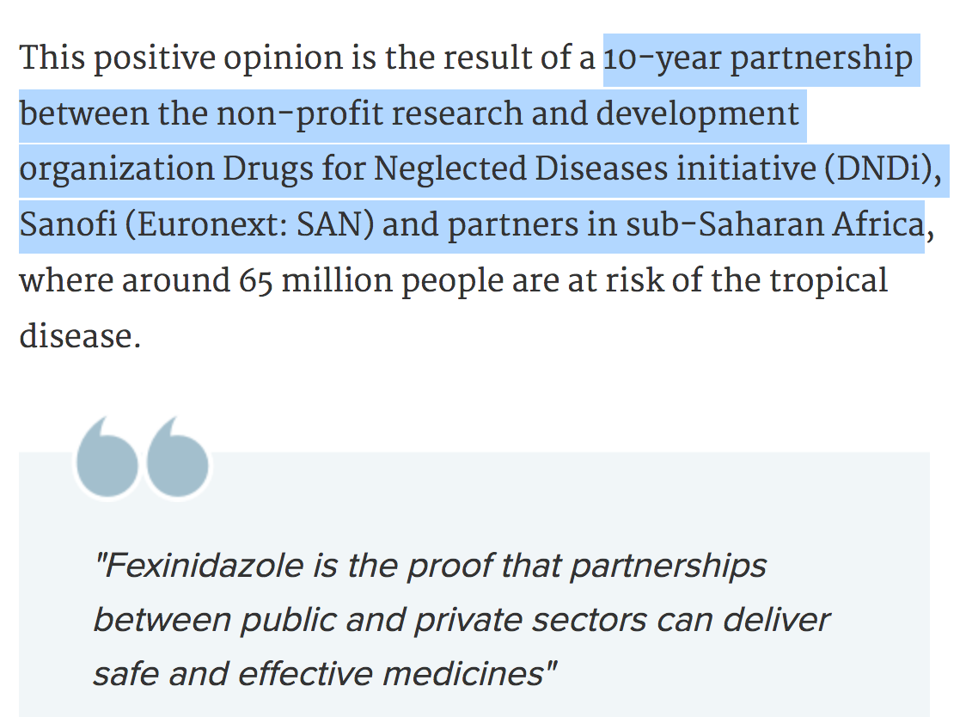
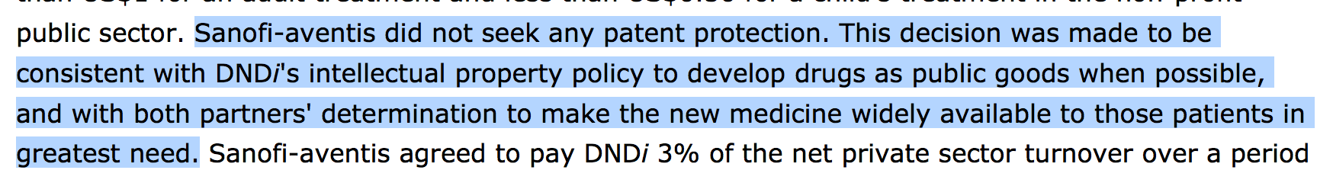
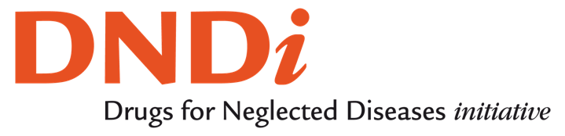
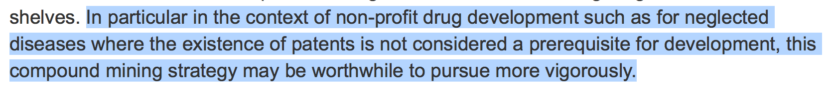
12/30
We Know Patents Aren’t Necessary
Penicillin, The Polio Vaccine
ASAQ/Coarsucam
Bompart F, Kiechel JR, Sebbag R, Pecoul B (2011) Innovative Public-Private Partnerships to Maximize the Delivery of Anti-malarial Medicines: Lessons Learned from the ASAQ Winthrop Experience. Malaria Journal 10:143. doi:10.1186/1475-2875-10-143
Fexinidazole
PharmaLetter 22/11/18
Torreele E, Bourdin Trunz B, Tweats D, Kaiser M, Brun R, Mazué G, et al. (2010) Fexinidazole – A New Oral Nitroimidazole Drug Candidate Entering Clinical Development for the Treatment of Sleeping Sickness. PLoS Negl Trop Dis 4(12): e923. doi:10.1371/journal.pntd.0000923

Slide 13
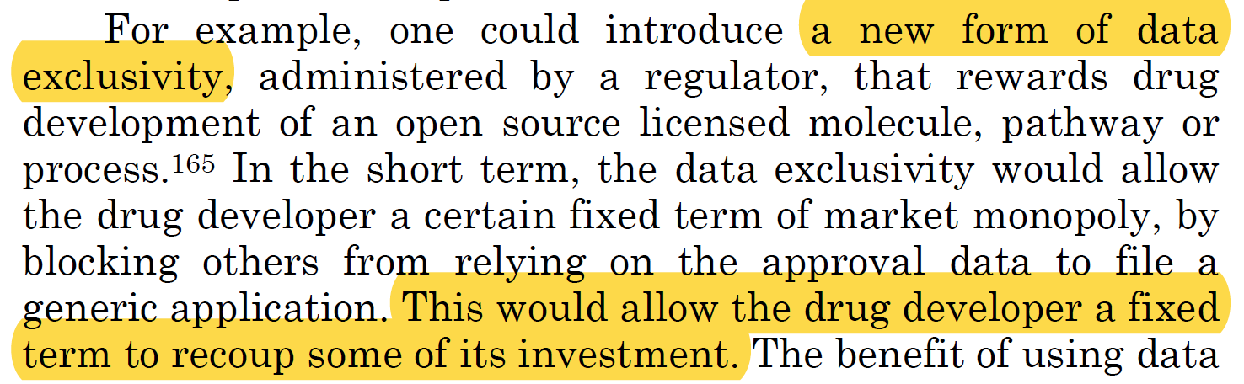
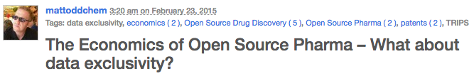
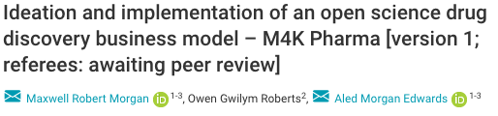
An Alternative to Patents Based on Exclusivities
13/30
Diverse Funding of Open Source Drug Discovery
|
|
Protection from Competition (make money back?
|
|
Drug Goes Generic
Emily Marden, Minn. J. L. Sci. Tech, 2010, 11, 217
(https://scholarship.law.umn.edu/mjlst/vol11/iss1/10/)
Me, Intermolecular Blog 2015
Al Edwards and team, Wellcome Open Res. 2018, 3:154

Slide 14

M4ID as Private Sector Developer of Open Assets
14/30
https://www.m4idpharma.com/

Slide 15
15/30
So we’d like to scale up
Some things work
Some things don’t
What are the most scalable solutions?

Slide 16

https://www.flickr.com/photos/mary_hutchison/38097985555, CC BY-NC-ND 2.0

Slide 17
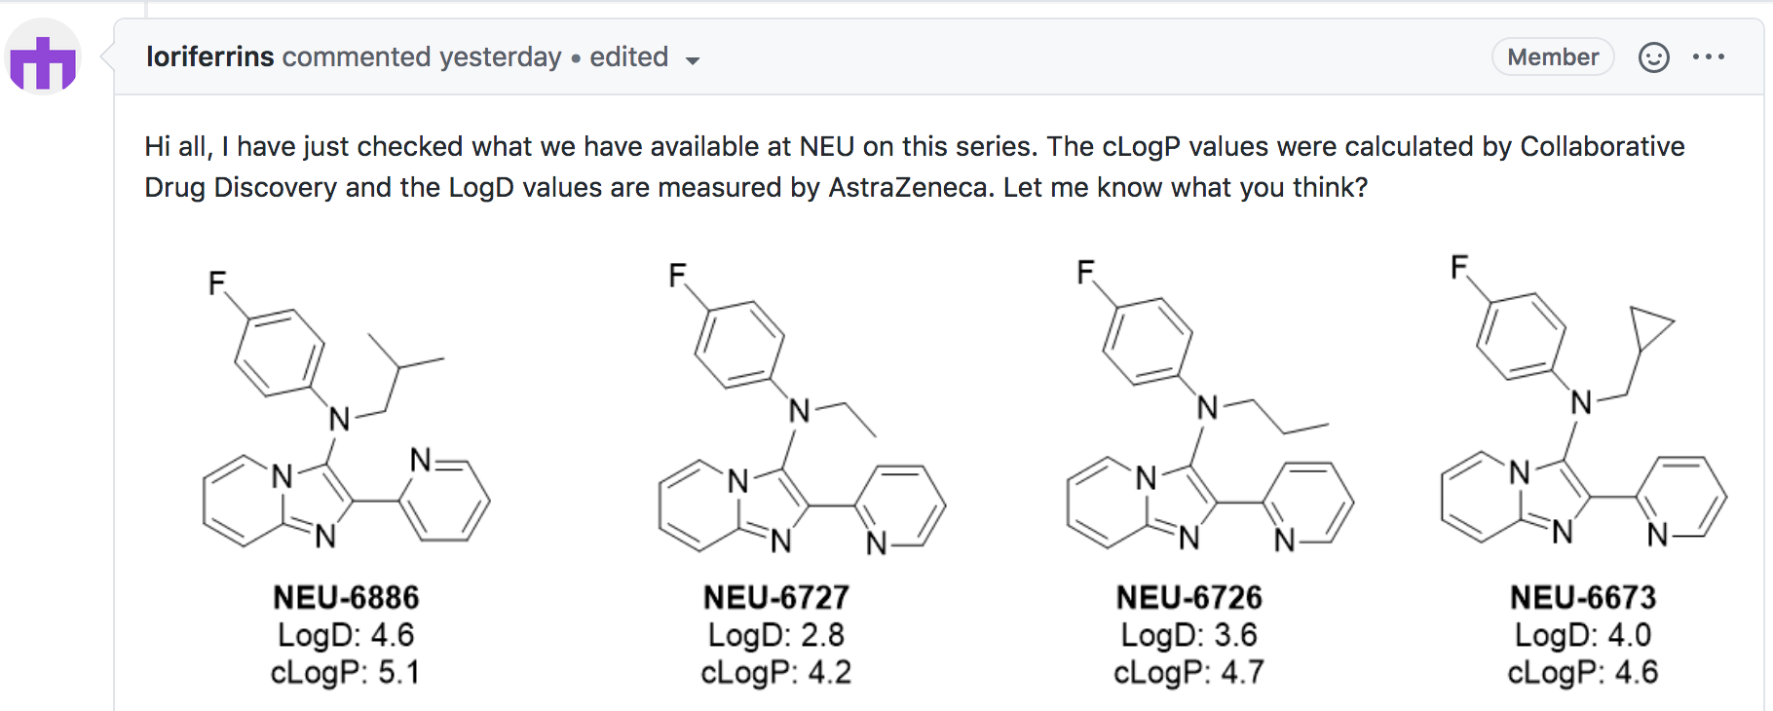
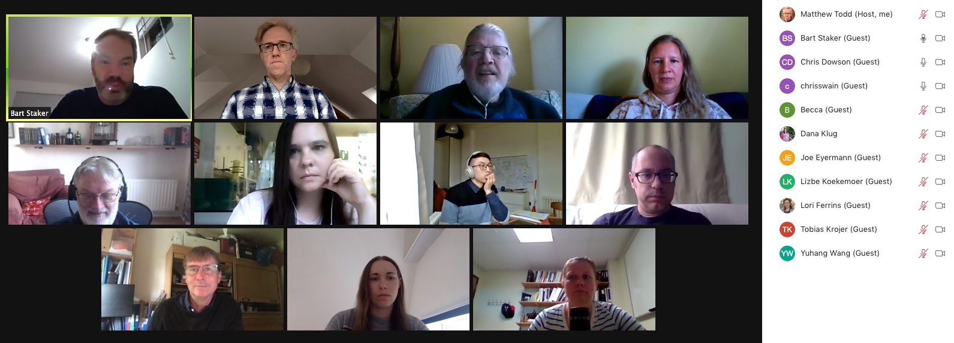
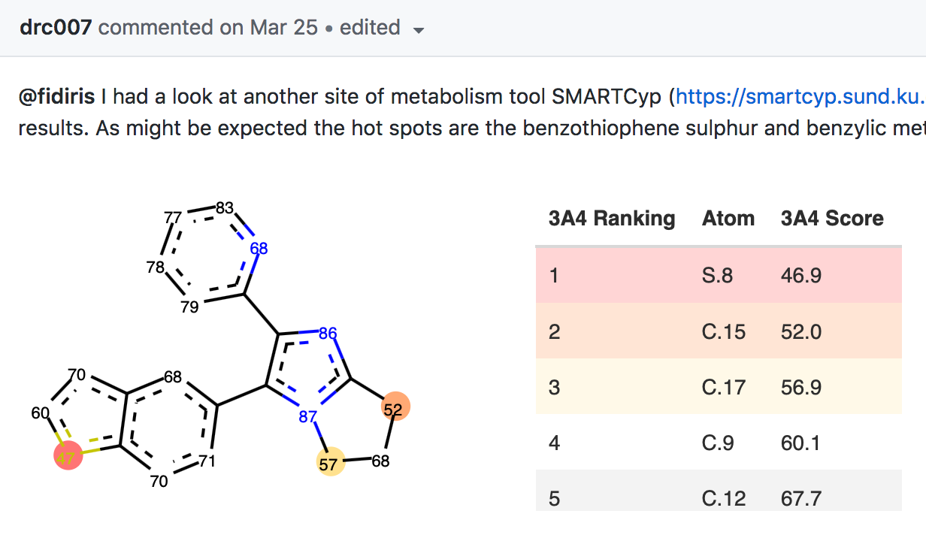
17/30
Molecules are Invisible in Discussions
17/18

Slide 18
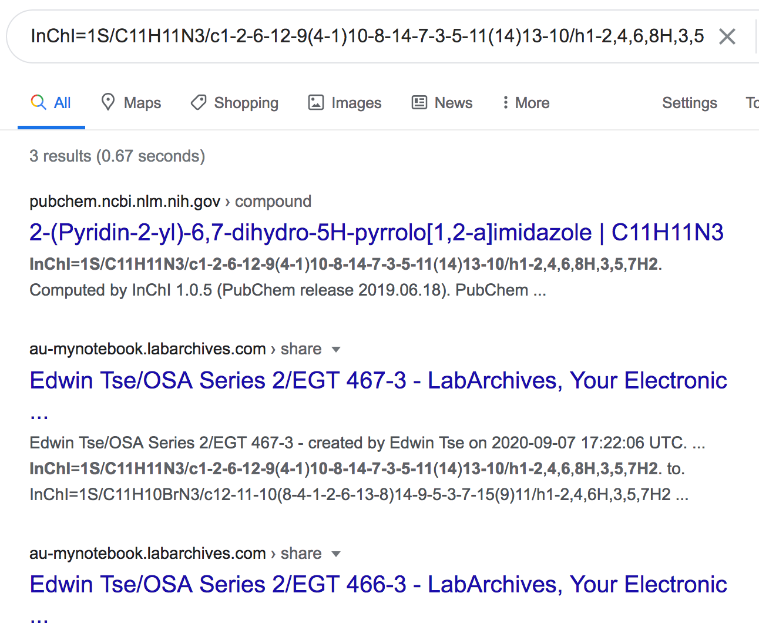
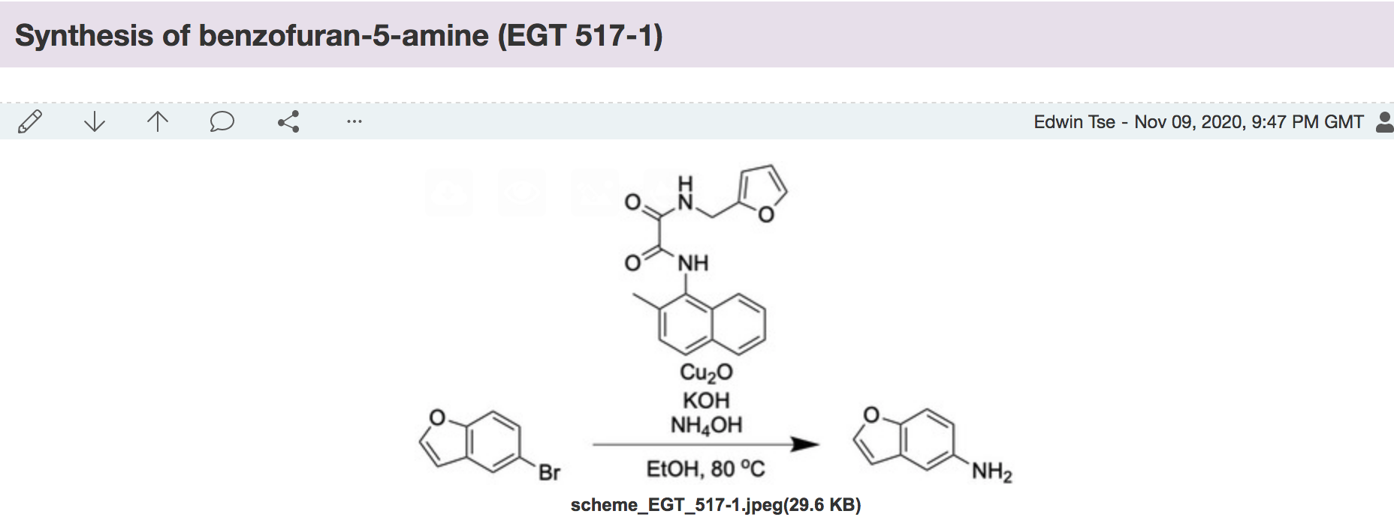
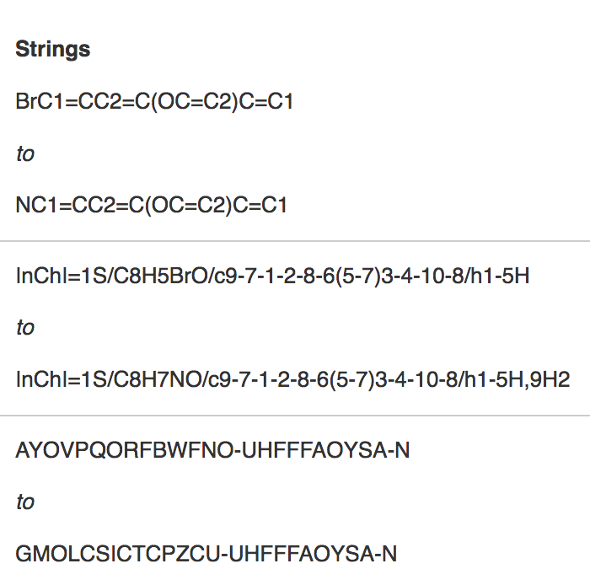
18/30
Absolute Bedrock: The ELN
What do we say to members of the community
(undergrads, postdocs, academia, industry, UK, US, China, Ghana)
Who want to contribute experiments?

Slide 19
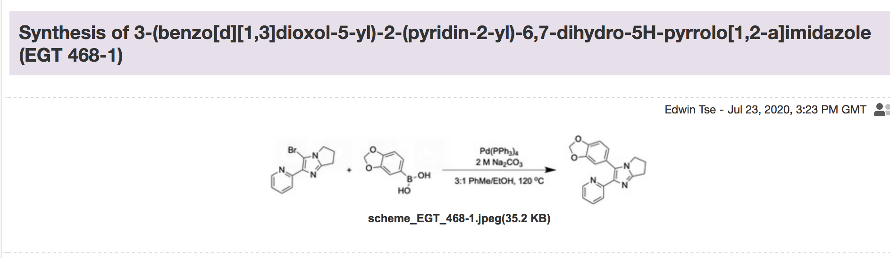
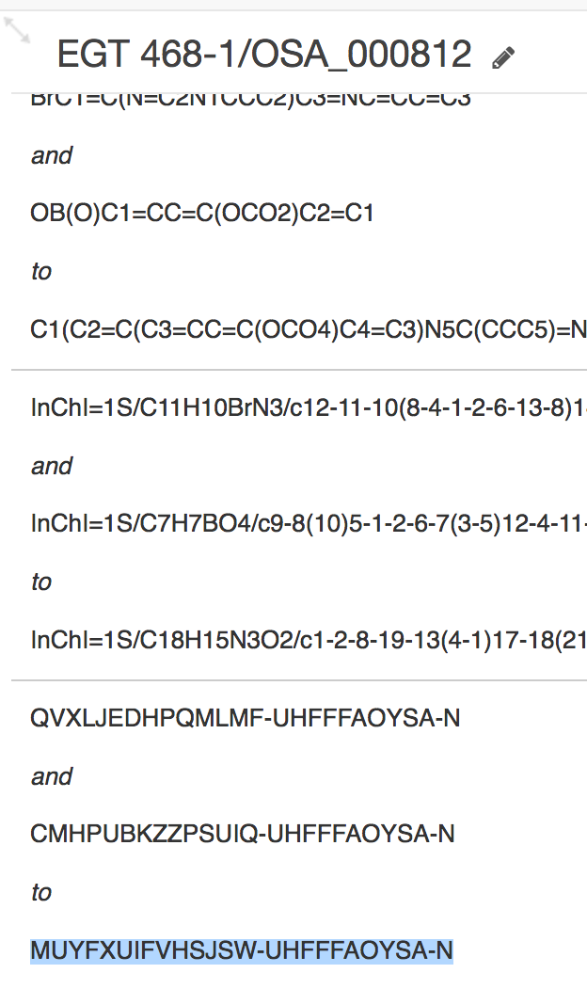
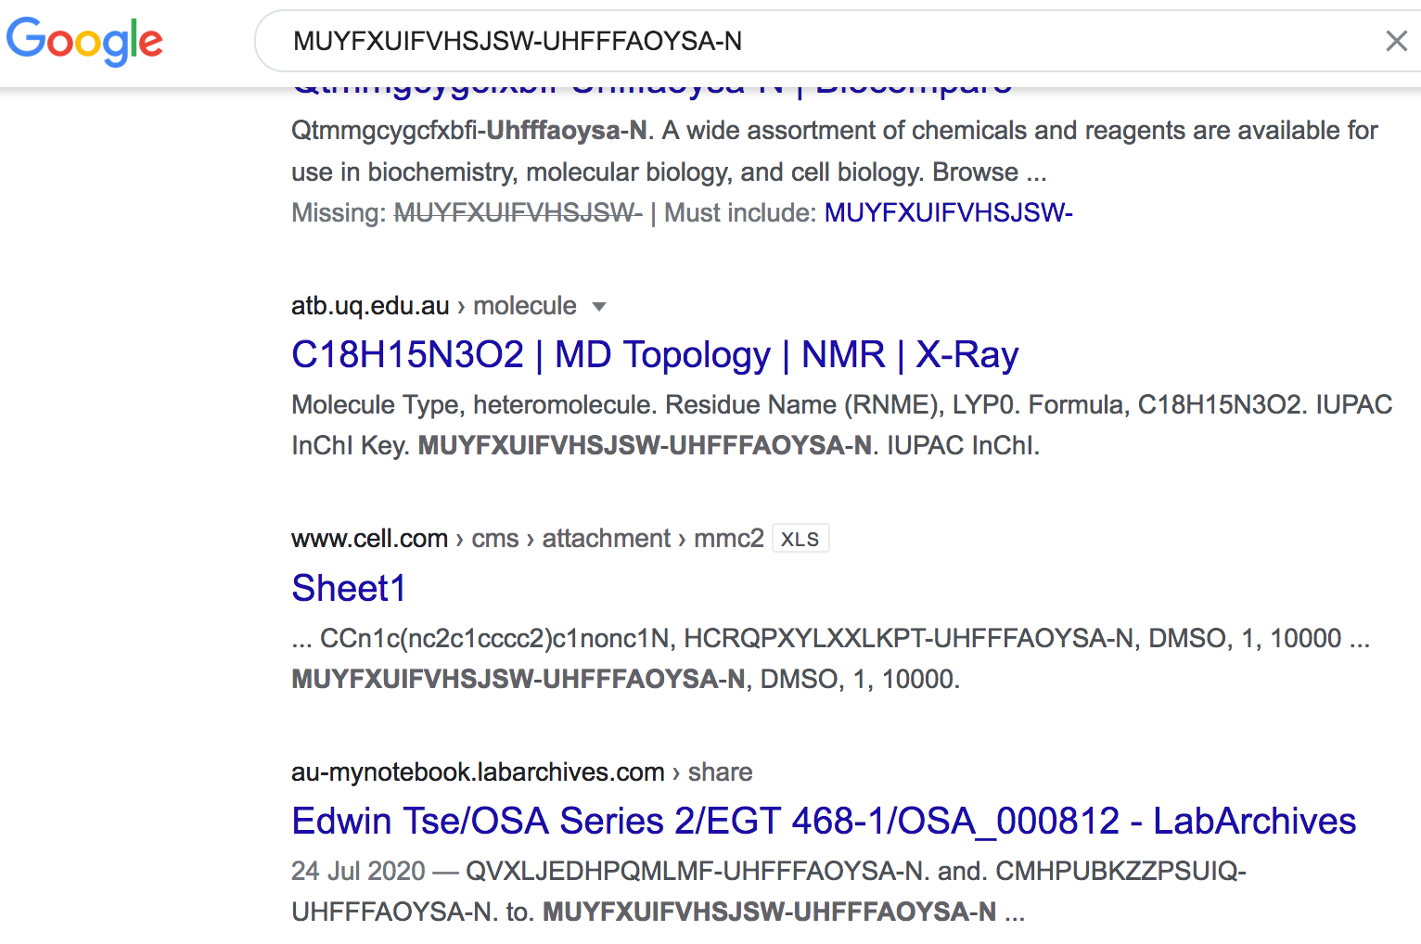
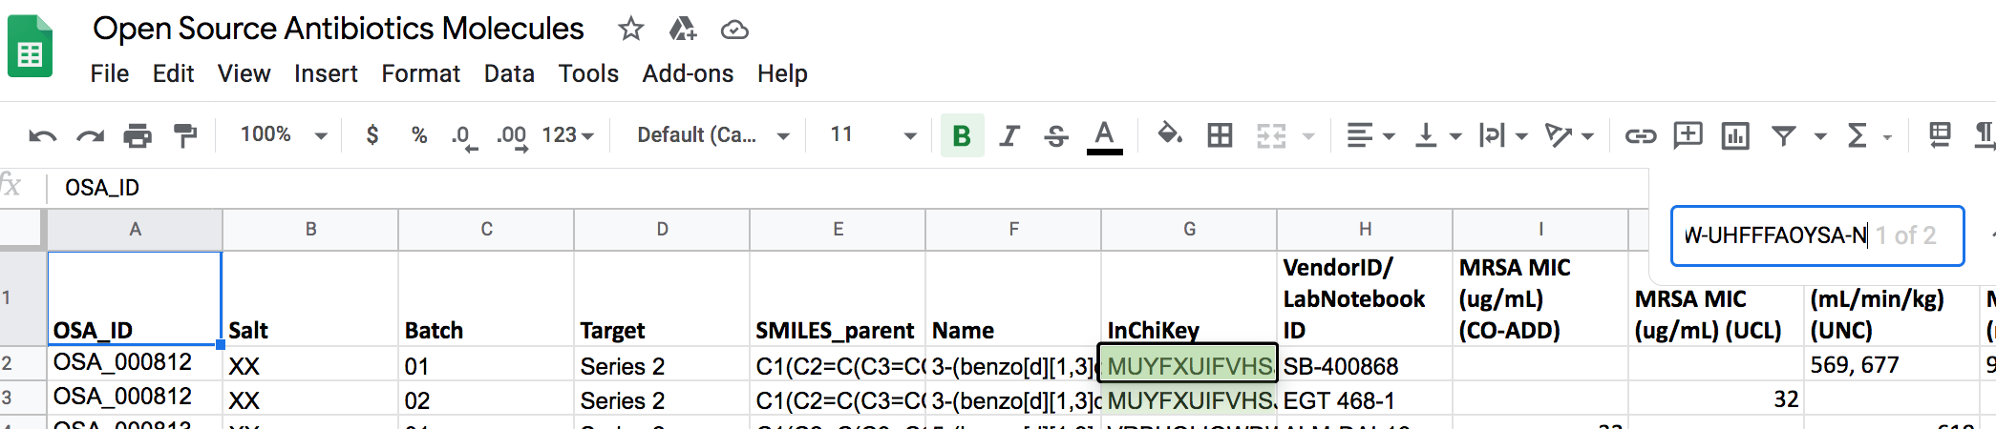
19/30
Some sources discoverable, others not

Slide 20
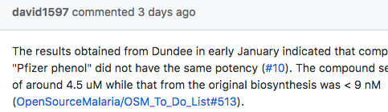
Need Better Ways to “Mention” Molecules
20/30
Over-arching problem: the platform doesn’t understand molecules, and doesn’t understand us talking about molecules.
Got: Understands and cross-links discussion pages. Useful.
Blah blah MOL#56 blah blah
Want: Github performs lookup from Master Molecule List. Understands, and inserts metadata

Slide 21
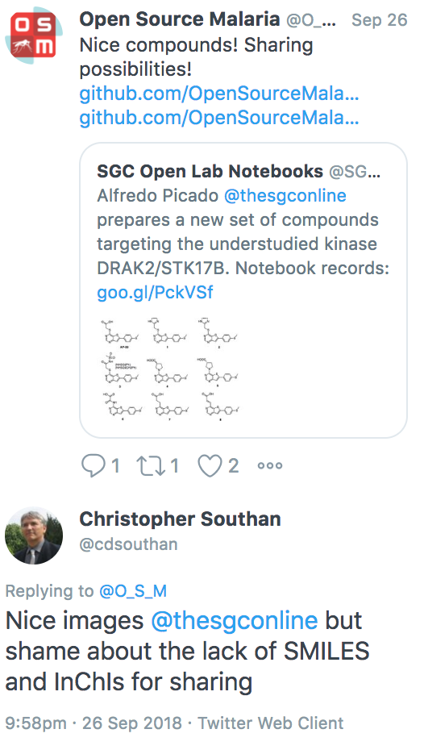
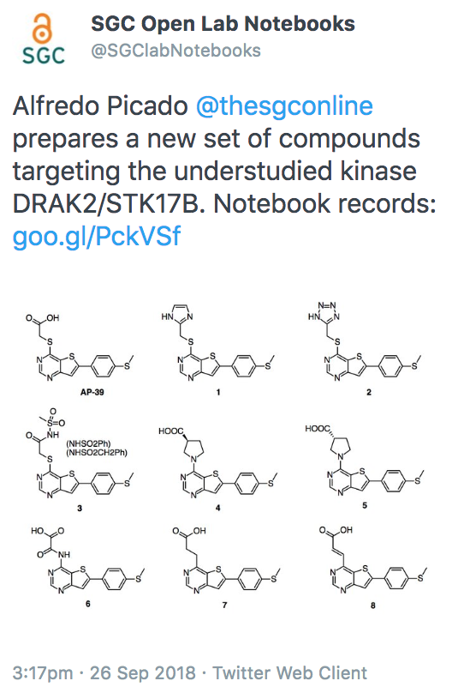
21/30
17/18
Still too easy to miss relevant work

Slide 22
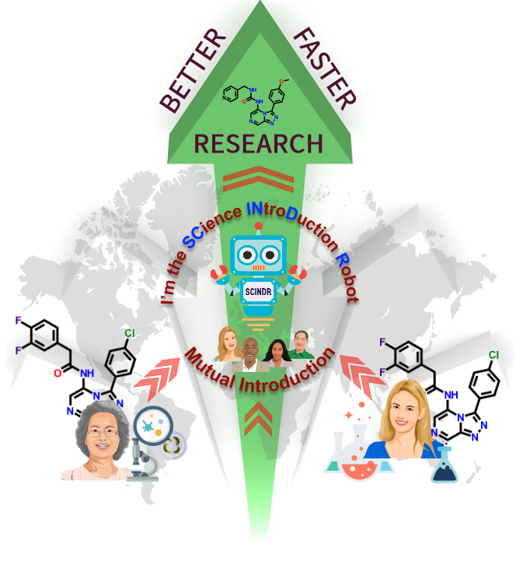

22/30
Should Help People Make Connections
What you’re working on
connects to
What else is out there
It’s called
The Science Introduction Robot
or, well,
SCINDR
Research Ideas and Outcomes 2: e9995 (27 Jul 2016). DOI: 10.3897/rio.2.e9995
Luc Patiny’s lab notebook C6H6: Mag. Res. Chem., 2018, 56, 520–528.

Slide 23
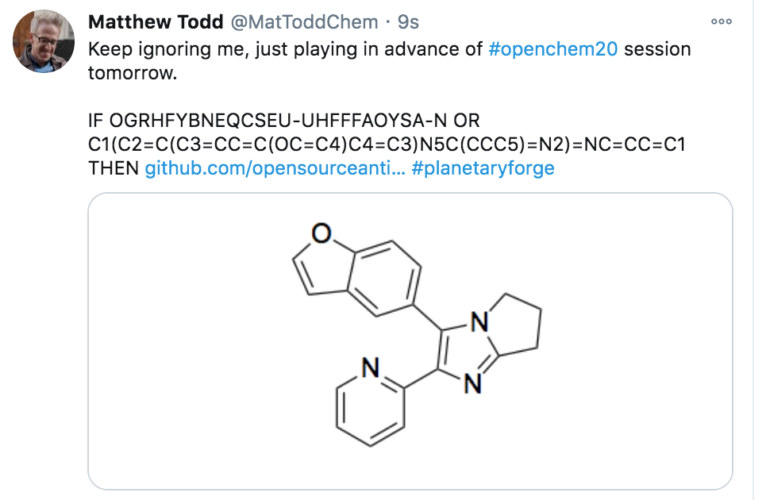
Although…
23/30

Slide 24
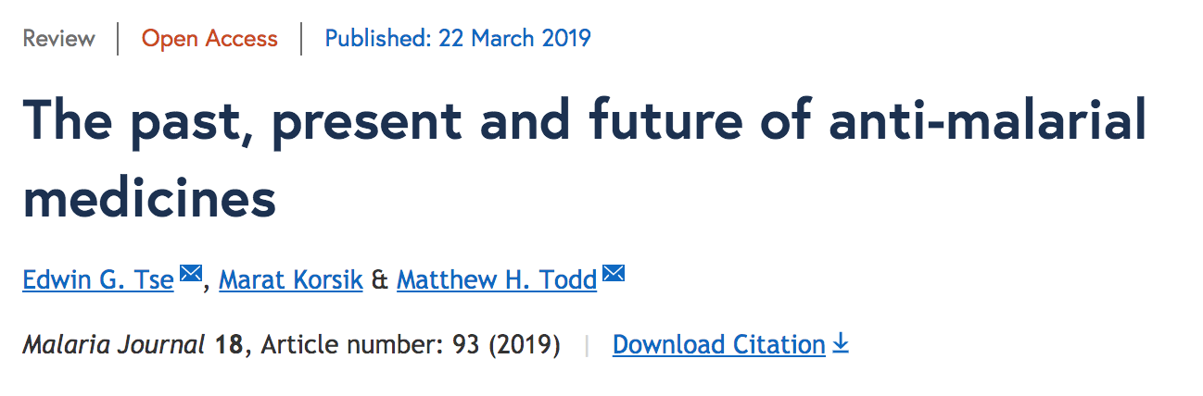
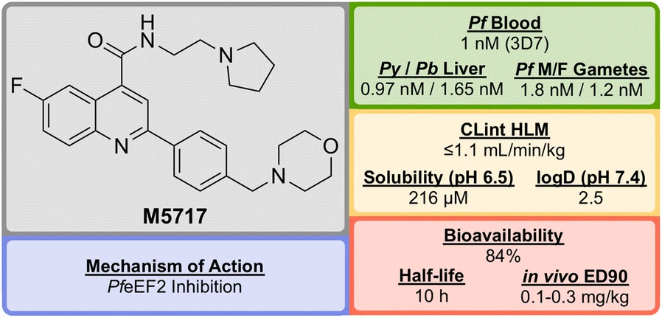
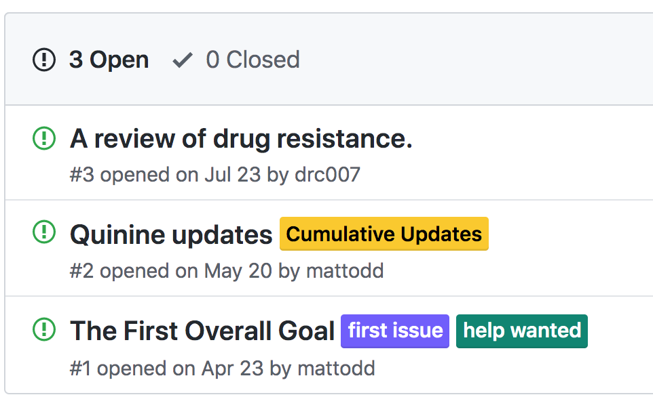
24/30
Authorship: Living Pipeline Review
https://github.com/OpenSourceMalaria/pipeline_living_review

Slide 25
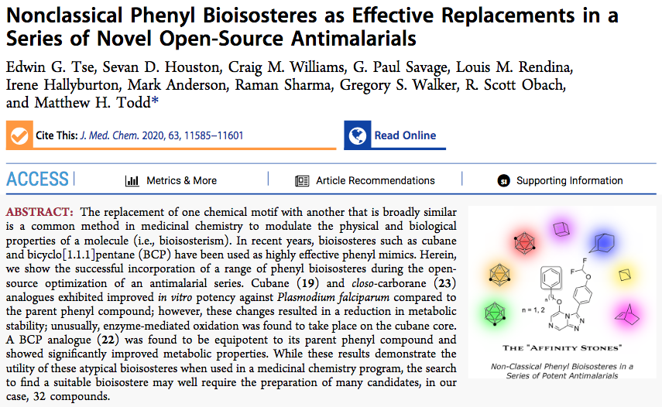



25/30
Traditional Outputs Remain Important

Slide 26



26/30
Publishing Open Projects Requires…Care

Slide 27
27/30
FAIR Report Card
Findability
Data, project easy to find.
Maximal persistence of resources
Current issues are written up and assigned to people
But data not well folded in, so it’s hard to understand from outside
Cells of project are not well interlinked
Accessibility
Easy to work with the consortium of people
Examples of crowdsourcing, spontaneous inputs
Still relies on human gatekeepers/shepherds
Automatic metadata generation not great
Interoperability
Relatively easy to have inter-operable data, platform, standards
More difficult to have inter-operable procedures
Many legacy format preferences, e.g. Chemdraw, Office, PDF
Reusability
Licence of the project (clearly) stated: CC-BY-4.0
Much raw data/recipes available and may be reused (and have been)
but lots of gaps
…and inexhaustible supply of molecules, anyone?

Slide 28
28/30
Beyond FAIR
Correctability
As with any project, mistakes can be made and must be corrected
An immediately-online project must ensure good data percolate through
..but if the data have already been mined…
Storifiability
Still too hard to keep The Story So Far updated
Presents small but powerful barrier to external, autonomous inputs
Economic Viability
Openness makes research better/faster
Open research can lead to big scale manufactured outcomes that impact society
Clonability
If something works, it ought to be easy to replicate the structure

Slide 29
29/30
Three Take-Homes
Open is better/faster/more fun. So aim for planetary-scale open, collaborative chemistry.
There are ways to translate open science into new medicines for patients.
If we are expecting major inputs, what are the solutions we should deploy? How do we balance open source tools vs. supported, proprietary ones?
Is the best hope tools that are developed, and free by virtue of ubiquity?

Slide 30















My Lab: Alice Williamson, Ed Tse, Michael Woelfe, Paul Ylioja, Murray Robertson, David Smith, Kat Badiola, Jessica Baiget, Javier Osende, Jimmy Cronshaw, Zoe Hungerford, Laura White, Clara Chen, Angela Butera, Matin Dean, Althea Tsang, Jo Ubels, Tom MacDonald, Matt Tarnowski, Peter Turner, Carmen Tran, Inga Topolnicki, Haochuan Mao, Tianyi Zheng, Jasper Tyler, Mathamsanqa Bhebhe, Marat Korsik, Fahima Idiris, Dana Klug, Dmitrij Melechov MMV: Tim Wells, Paul Willis, Jeremy Burrows DNDi: Ben Perry, Jean-Robert Ioset GSK: Javier Gamo, Felix Calderon, Lluis Ballell, Julia Castro-Pichel, Carlos Alemparte, Benigno Crespo Sydney Grammar School: Malcolm Binns, Erin Sheridan, the boys WHO/TDR: Piero Olliaro SGC: Aled Edwards, Rafael Counago Syncom B.V.: Jean-Paul Seerden Massachusetts College of Pharmacy and Health Sciences: Chase Smith and students Dundee: Irene Hallyburton Southampton: Jeremy Frey and team ChEMBL: John Overington, Iain Wallace, George Papadatos ANU: Kiaran Kirk, Adele Lehane, Adelaide Dennis OSDD India: Sanjay Batra, Soumya Bhattacharyya Griffith: Vicky Avery, Sandra Duffy, Sabine Fletcher, Mark Coster and student teams Monash: Sue Charman, Karen White, David Shackleford, Darren Creek, Anubhav Srivastava Melbourne: Stuart Ralph, James Pham Basel: Sergio Wittlin Edinburgh: Patrick Thompson, Eduvie Omene, Devon Scott, Tom Foley Pfizer: Scott Obach, Christine Orozco Lawrence University: Stefan Debbert and students Haverford College: Robert Broadrup Karolinska Institute: Sabin Llona-Minguez University of British Columbia: Corey Nislow, Marinella Gebbia, Anna Lee Asclepia: Frederick DeRoose ExScientia: Willem van Hoorn UCSD: Stephan Meister, Elizabeth Winzeler, Sabine Ottilie Imperial College: Michael Delves, Andrea Ruecker Erasmus MC: Wendy van der Sande St Jude’s Hospital: Kip Guy, Julie Clark Other Online: Chris Southan, Jonathan Baell, Chris Swain, Egon Willighagen, Vito Spadavecchio, Mandrake Fernflower, Ho Leung, and everyone else

